Slide 1
Computer Architecture
Reference:
- Mano, “Computer System Architecture”, Prentice Hall Int., 1993
Central Processing Unit Architecture
  Design Approaches [Stack – Pipelining – Interrupt – Processor Organization
– Registers Organization]
  Instruction Set Architecture [Instruction Format – Addressing modes –
Data Transfer and Manipulation]
  Example architectures (e.g. CISC, RISC)
Timing, Clock Parameters, and Processor Performance
Memory Hierarchy
  Main Memory
  Cache Memory
  Virtual Memory 2
Computer Architecture Module Content

Slide 2
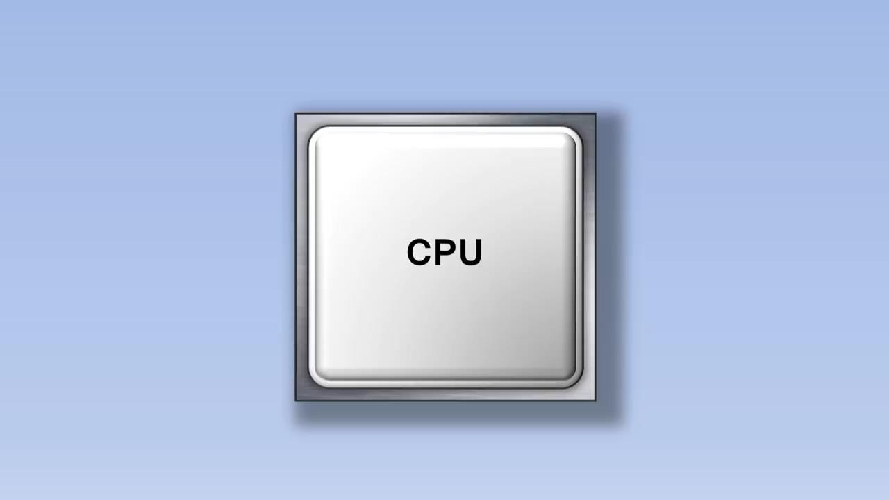
https://www.youtube.com/watch?v=cNN_tTXABUA
Addressing Modes Review
4

Slide 3
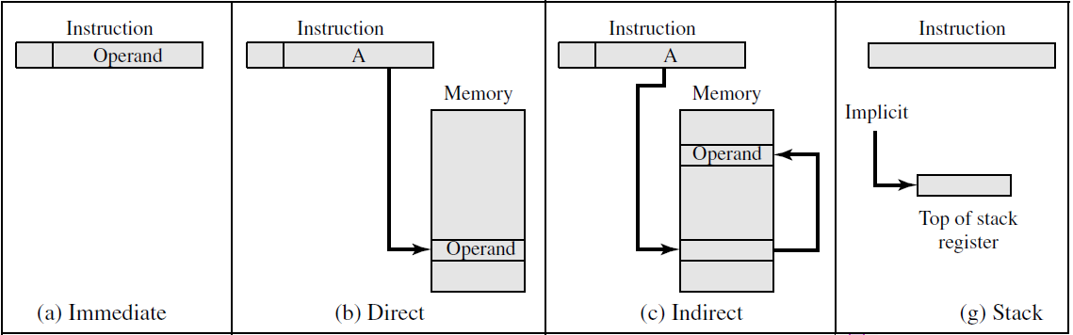
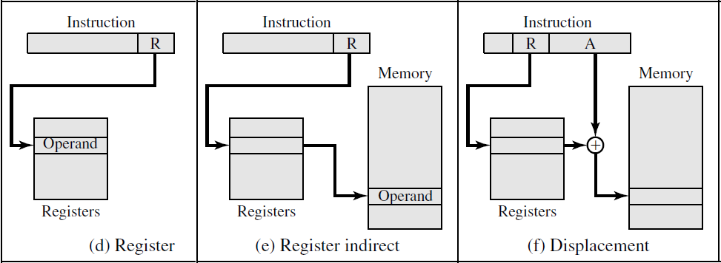
Types of Addressing Modes
Types of Addressing Modes

Slide 4
Relative Addressing Modes
The address field of the instruction is added to the content of a specific register in the CPU.
effective address = address part of instruction + content of CPU register
The CPU register used in the computation may be the program counter (PC), an index register (IX), or a base register(BAR).
  PC Relative Addressing mode
  Indexed Addressing Mode
  Base Register Addressing Mode
Relative Addressing Modes
Applications:
  Branch-type instructions (e.g. while loop, do while, for loop)
  Large physical memory can be accessed with a small number of address bits in the instruction. The Address fields in the instruction specify a part of the address (abbreviated address) which can be used along with a designated register to calculate the address of the operand.
The address part of the instruction is usually a signed number
(in 2’ s complement representation) which can be either positive or negative.

Slide 5
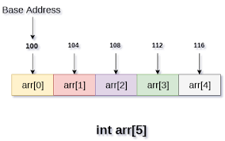
Relative Addressing Modes
EA = IR(address) + R, R is sometimes implied
  PC Relative Addressing mode EA = PC + IR(address)
  Indexed Addressing Mode EA = IX + IR(address)
  Base Register Addressing Mode EA = BAR + IR(address)
Relative Addressing Modes
Indexed Addressing Mode EA = IX + IR(address)
Index register is assumed to hold an index number
Base Register Addressing Mode
Base register is assumed to hold a base address.
EA = BAR + IR(address)

Slide 6
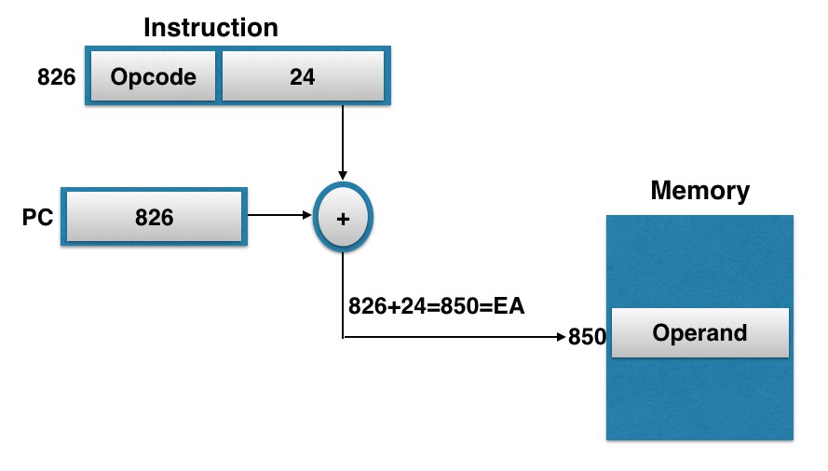
PC Relative Address mode
Also called the Relative Address mode
The position of the effective address in memory is relative to the address of the next instruction.
Example:
  program counter = 825
  The address part of the instruction contains the number 24.
The instruction at location 825 is read from memory during the fetch phase and the program counter is then incremented by one to 826.
The effective address computation for the relative address mode is 826 + 24 = 850. This is 24 memory locations forward from the address of the next instruction.
PC Relative Addressing mode
825

Slide 7
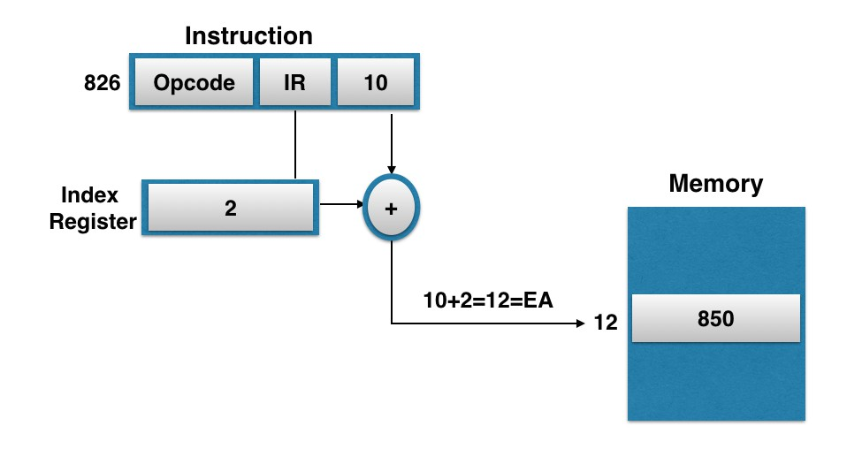
Indexed Addressing Mode
The content of an index register is added to the address part of the instruction to obtain the effective address.
An index register is assumed to hold an index number that is relative to the
address part of the instruction.
The address field of the instruction defines the beginning address of a data array in memory.
Any operand in the array can be accessed with the same instruction provided that the index register contains the correct index value.
Some computers dedicate one CPU register to function only as an index register.
This register is involved implicitly when the index-mode instruction is used.
Indexed Addressing Mode

Slide 8
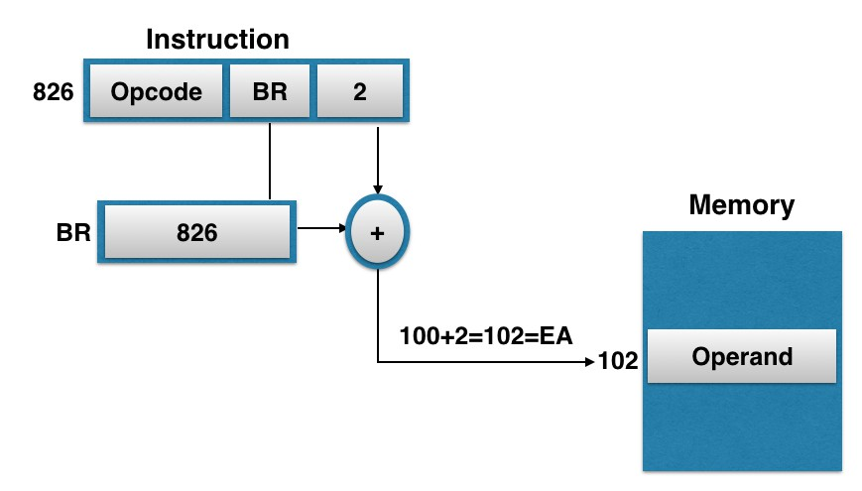
Base Register Addressing Mode
The content of a base register is added to the address part of the instruction to obtain the effective address.
A base register is assumed to hold a base address.
The address field of the instruction gives a displacement relative to this base address.
The base register addressing mode is used in computers to facilitate the relocation of programs in memory. In multiprogramming systems, when programs and data are moved from one segment of memory to another, the instructions' address values must reflect this position change.
With a base register, the displacement values of instructions do not have to change. Only the value of the base register requires updating to reflect the beginning of a new memory segment.
Base Register Addressing mode
100

Slide 9
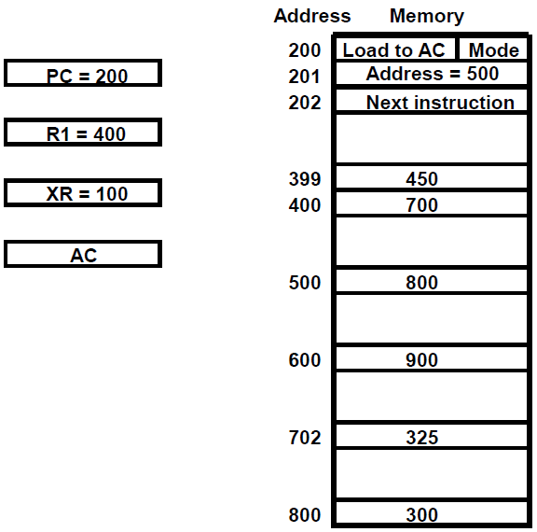
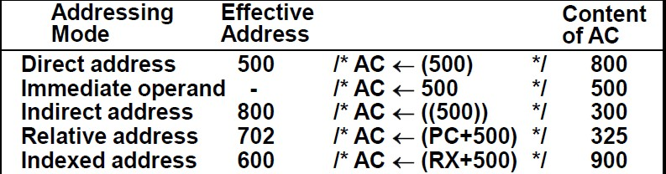
Example 1
Load operation
Example 1
Load operation

Slide 10
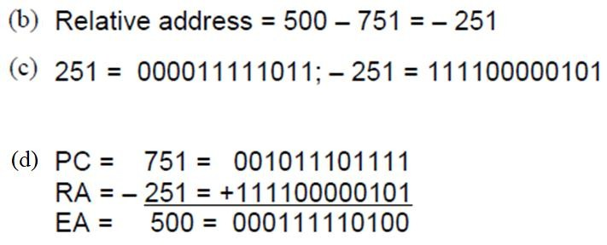
Example 2
A relative mode branch type instruction is stored in memory at address 750. The branch is at address 500.
  Determine the binary value in PC after the fetch phase and calculate the binary value of 500.
  What should be the value of the relative address field of the instruction?
  Determine the relative address value in binary using 12 bits.
  Show that the binary value in PC plus the relative address calculated in part (b) is equal to the binary value of 500.
Example 2

Slide 11
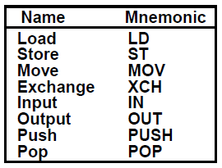
Data Transfer and Manipulation
21
Data Transfer Instructions
Typical Data Transfer Instructions

Slide 12
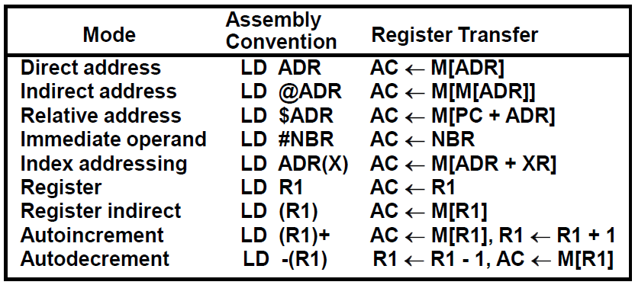
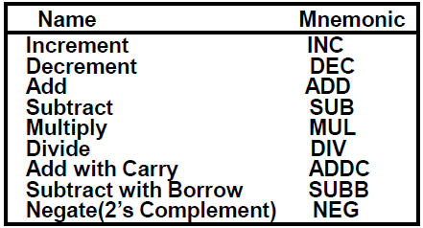
Data Transfer Instructions
LOAD Instruction with Different Addressing Modes
ADR ~ address
Data Manipulation Instructions
Arithmetic Instructions

Slide 13
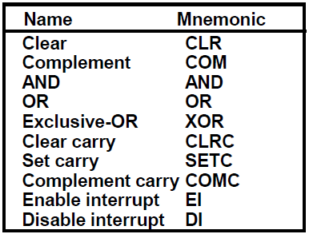
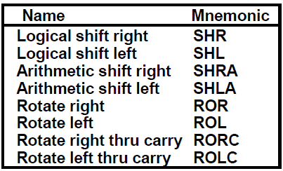
Data Manipulation Instructions
Logical and Bit Manipulation Instructions
Data Manipulation Instructions
Shift Instructions

Slide 14
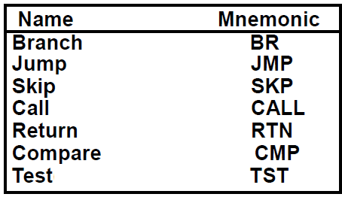
Program Control Instructions
Program Control Instructions
Jump is unconditional.
Branch is relative because they are conditional.
Compare executes a subtraction operation
Test executes an AND operation.
  CMP and TST instructions do not retain their results of operations. They only set or clear certain Flags.
Flags, Processor Status Word
In most processors, flags are combined into a register
  The processor status register (PSR)
  Sometimes called a processor status word (PSW)

Slide 15
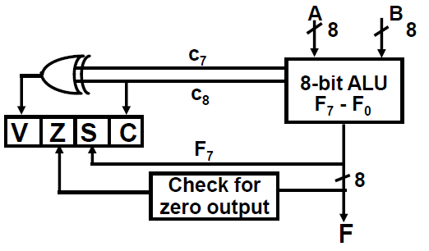
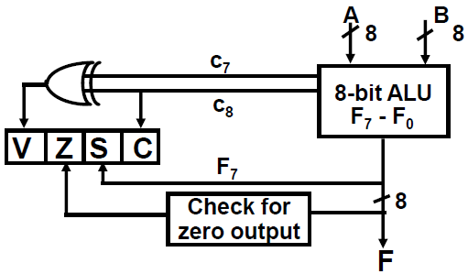
Flags, Processor Status Word
Common ALU flags
  S (Sign): The MSB bit of the ALU’s output.
  Z (Zero): Set to 1 if the ALU’s output is all 0’s.
  C: Carry bit.
  V: Overflow
Status Flag Circuit
Unsigned and Signed numbers
For 8-bit ALU,
  The largest unsigned number that can be accommodated in 8 bits is 255.
  The range of signed numbers is between + 127 and - 128.
  The addition and subtraction of two numbers is the same whether they are unsigned or signed (in 2's complement representation).

Slide 16
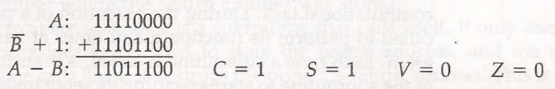
Flags, Processor Status Word
Bit C (carry) is set to 1 if the end carry C8 is 1. It is cleared to 0 if the carry is 0.
Bit S (sign) is set to 1 if the highest-order bit F7 is 1. It is set to 0 if the bit is 0.
Bit Z (zero) is set to 1 if the output of the ALU contains all 0’s.
Z = 1 if the output is equal to zero and Z = 1 if the output is not zero.
Bit V (overflow) is set to 1 if the XOR of the last two carries is equal to 1, and cleared to 0 otherwise.
This condition is set when negative numbers, in 2's complement, go over its limits.
For the 8-bit ALU, V = 1 if the output is greater than + 127 or less than -128.
Unsigned and Signed numbers
Let A = 11110000 and B = 00010100. To perform A - B, the ALU takes the 2’s complement of B and adds it to A.
C = 1 because there is a carry-out of the last stage.
S = 1 because the leftmost bit is 1.
V = 0 because the last two carries are both equal to 1
Z = 0 because the result is not equal to 0.
The compare instruction updates the status bits.

Slide 17
Signed numbers
Let A = 11110000 and B = 00010100. To perform A - B, the ALU takes the 2’s complement of B and adds it to A.
The decimal equivalent of A is -16 and B is +20.
The subtraction in decimal is (-16) - (+20) = - 36 = (11011100)_{b} which is the 2’s complement of 00100100, equivalent to decimal -36.
We have that A < B and A ≠ B. These two relations can be derived from the fact that status bits S = 1 (negative), V = 0 (no overflow), and Z = 0 (not zero).
Signed numbers
The relative magnitude of two signed numbers can be determined from the
values of S, V, and Z.
With V = 0, if S = 0 (A > B) and if S = 1 (A < B) with V = 1 reverse
Z =1 (equal)

Slide 18
Unsigned numbers
Let A = 11110000 and B = 00010100. To perform A - B, the ALU takes the 2’s complement of B and adds it to A.
If we assume unsigned numbers, the decimal equivalent of A is 240 and that of B is 20.
The subtraction in decimal is 240 - 20 = 220 = (11011100)_{b}
We have A > B and A ≠ B. These two relations can be derived from the fact that status bit C is equal to 1 and bit Z is equal to 0.
Unsigned numbers
The relative magnitude of two unsigned numbers can be determined (after a compare instruction) from the values of status bits C and Z.
C = 1 (A > B) C = 0 (A < B)
Z =1 (equal)

Slide 19
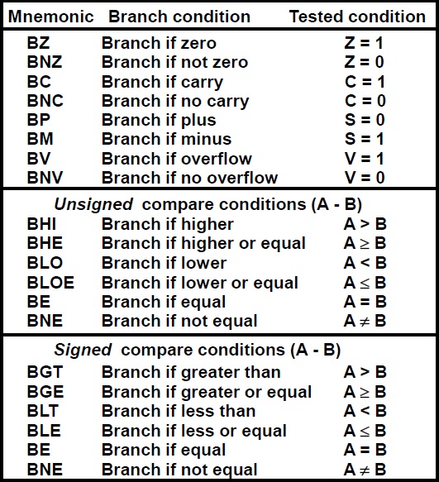
Conditional Branch
Instructions, Table 8-11
Interrupt and Subroutine
44

Slide 20
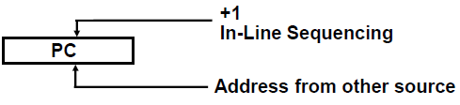
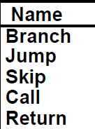
Program Control Instructions
Instructions are always stored in
successive memory locations.
Each time an instruction is fetched from memory, the program counter is incremented to contain the next instruction's address in sequence.
On the other hand, a program control type of instruction, when executed, may change the address value in the program counter and cause the flow of control to be altered.
Program Control Instructions
Program Control Instructions
The change in the value of the program counter as a result of the execution of a program control instruction causes a break in the sequence of instruction execution.
This is an important feature in digital computers, as it provides control over the flow of program execution and a capability for branching to different program segments.

Slide 21
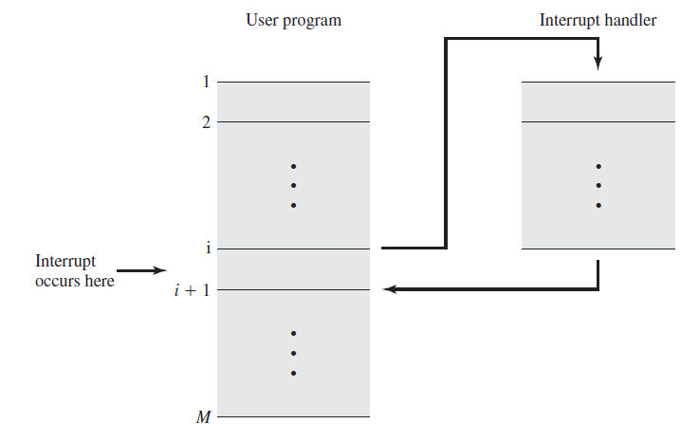
Transfer of Control via Interrupts
Subroutine/Interrupt Call and Return
Subroutine/Interrupt Call has Two Important Operations that are Implied
  Branch to the beginning of the Subroutine
  Save the Return Address to get the address of the location in the Calling Program upon exit from the Subroutine
CALL
M[x] ← PC PC ← EA
RETURN
PC ← M[x]

Slide 22
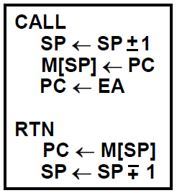
Locations for storing Return Address
Locations for storing Subroutine Address
  Fixed Location in the subroutine (Memory) [at start or end of subroutine]
  Fixed Location in memory
  In a processor Register
  In memory stack - most efficient way
    Stack
Locations for storing Return Address
Locations for storing Interrupt Address
  Some computers assign a memory location for each possible interrupt.
  Sometimes, the hardware interrupt provides its own address that directs the CPU to the desired service routine.

Slide 23
Interrupt
51
Interrupt Procedure
Program interrupt refers to the transfer of program control from a currently running program to another service program as a result of an external or internally generated request. Control returns to the original program after the service program is executed.
After a program has been interrupted and the service routine is executed, the CPU must return to the same state that it was when the interrupt occurred. It allows the interrupted program to be resumed exactly as if nothing had happened.

Slide 24
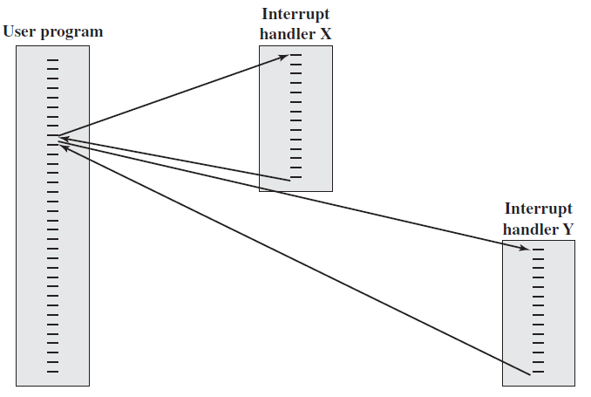
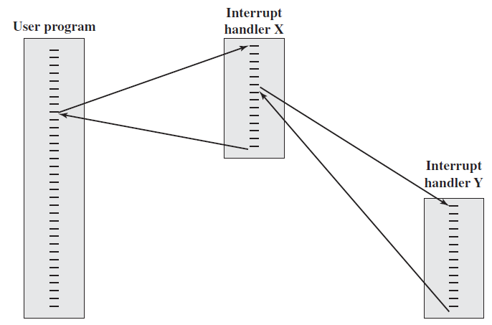
Sequential interrupt processing
Nested interrupt processing

Slide 25
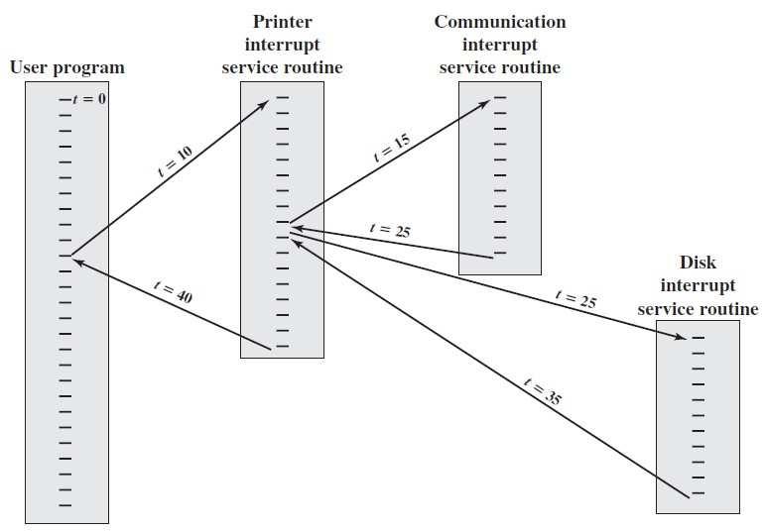
Example Time Sequence of Multiple Interrupts
Types of Interrupts
External interrupts
Internal interrupts (traps)
Software Interrupts

Slide 26
External interrupts
Initiated from the outside of the CPU and Memory. It comes from
  I/O Device (Mouse - Keyboard - Printer)
  Timing Device → Timeout may result from a program that is in an endless loop and thus exceeded its time allocation.
  Circuit monitoring the power supply → (Power Failure)
    Power failure service routine is a program that transfers the complete state of the CPU into a non-destructive memory in the few milliseconds before power is cut off.
Internal interrupts (traps)
Arise from illegal or invalid use of an instruction or data. It comes from
  Register or Stack Overflow
  Divide by zero
  Invalid OP-code
  Protection Violation
(e.g. read-only portion of memory, user mode tries to execute supervised instruction, read data from part of memory which are designated for instructions, …..)
The service program that processes the internal interrupt determines the corrective measure to be taken.

Slide 27
External vs. Internal Interrupts
Internal interrupts are synchronous with the program
External interrupts are asynchronous.
Both External and Internal Interrupts are initiated by the computer hardware (I/O devices or Control Unit).
Software Interrupt (Supervisor Call)
it is initiated by executing an instruction
  Switching from the user mode to the supervisor mode
When the CPU executes a program that is part of the operating system, it is said to be in the supervisor or system mode. A certain set of instructions are private and can be executed in system mode only and are not allowed in the user mode.
The CPU is normally in user mode when executing user programs.
The CPU operating mode is determined from a special status bit in the PSW.

Slide 28
Program Interrupt vs. Subroutine Call
The interrupt procedure is similar to a subroutine call except for:
  The interrupt is usually initiated by an internal or external signal rather than from the execution of an instruction (except for software interrupt).
  The address of the interrupt service program is determined by the hardware
rather than from the address field of an instruction.
  An interrupt procedure usually stores all the information necessary to define the state of the CPU rather than storing only the program counter.
Program Interrupt
The state of the CPU at the end of the execute cycle is determined by:
  The content of the program counter
  The content of all processor registers
  The content of certain status conditions

Slide 29
Program Interrupt
Saving the CPU state depends on the CPU architecture:
Only a few computers store both program counter (PC) and all status (PSW) and
register content in response to an interrupt.
Most computers just store the PC and the PSW.
  In some cases, there exist two sets of processor registers within the computer, one for each CPU mode.
Some computers store only the program counter when responding to an interrupt. The service program must then include instructions to store status and register content before these resources are used.
Interrupt Procedure
The CPU does not respond to an interrupt until the end of an instruction execution. Just before going to the next fetch phase.
The last instruction in the service program is a return from interrupt instruction. When this instruction is executed, the stack is popped to retrieve the old PSW and the return address. The PSW is transferred to the status register and the return address to the program counter (PC). Thus the CPU state is restored and the original program can continue executing.

